Slide 1
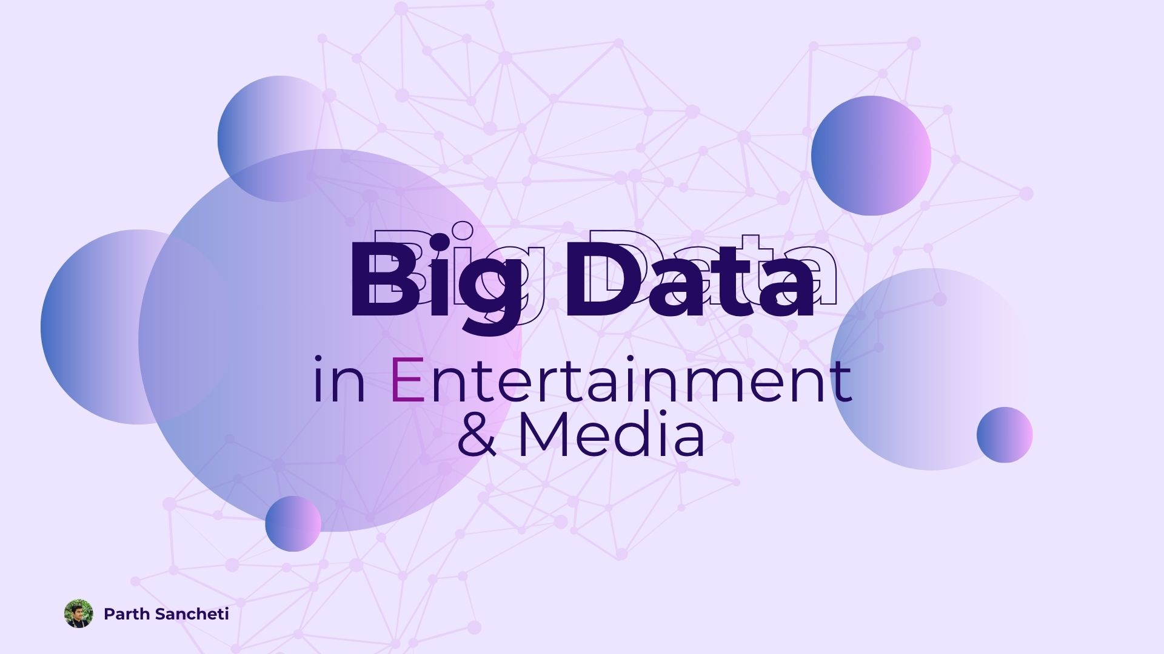

Slide 2
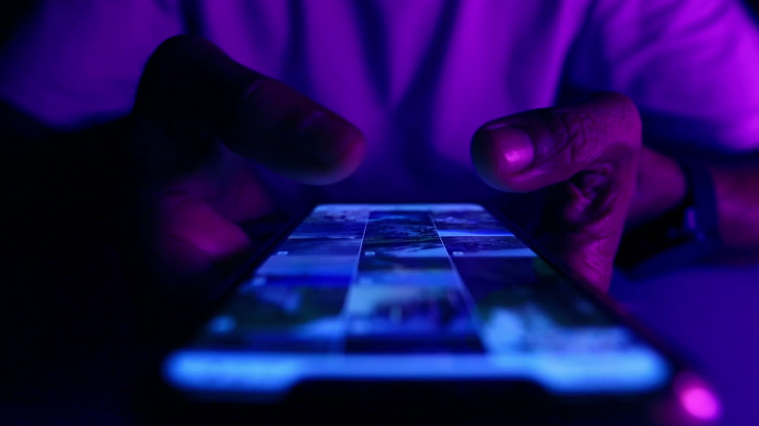
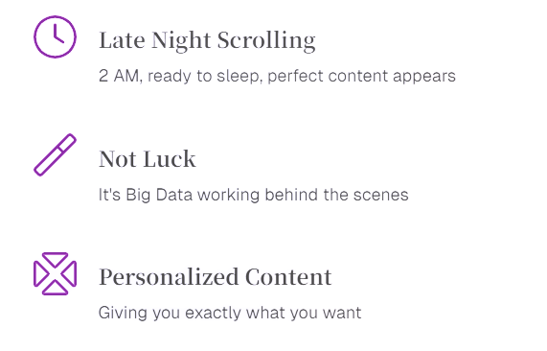
Why You Can’t
Stop Scrolling
Late Night Scrolling
2 AM, ready to sleep, perfect content appears
Not Luck
It's Big Data working behind the scenes
Personalized Content
Giving you exactly what you want

Slide 3






What Is Big Data?
Your Digital Breadcrumbs
Every like leaves a trace
Each emoji tells a story
Skip patterns reveal preferences
The Recipe for You Instagram collects, mixes, and serves content
Like a chef who knows your favorite flavors

Slide 4
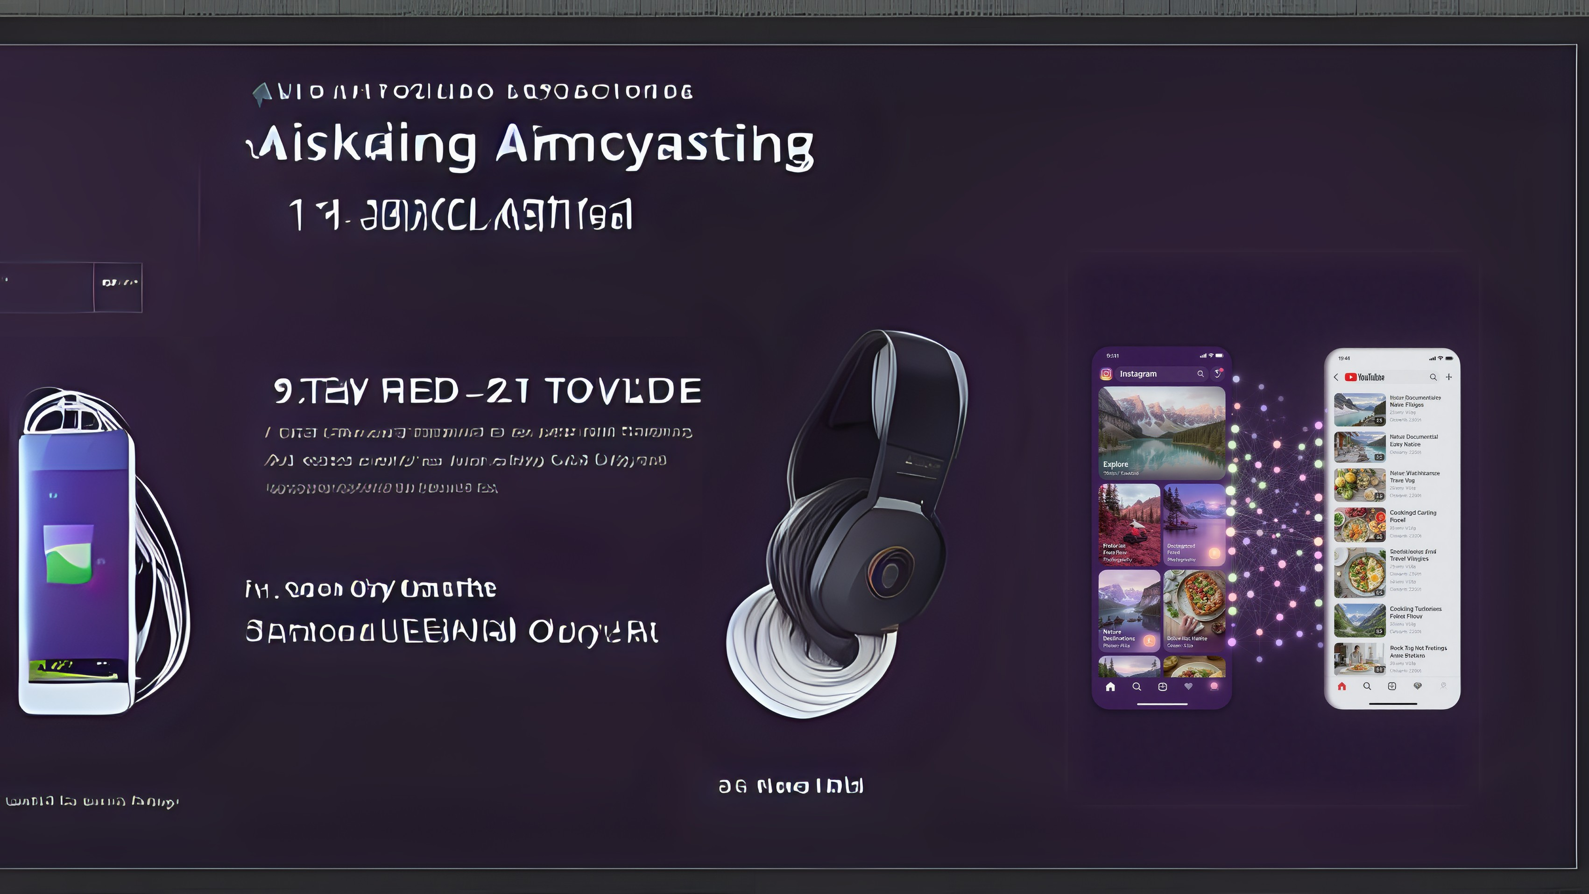
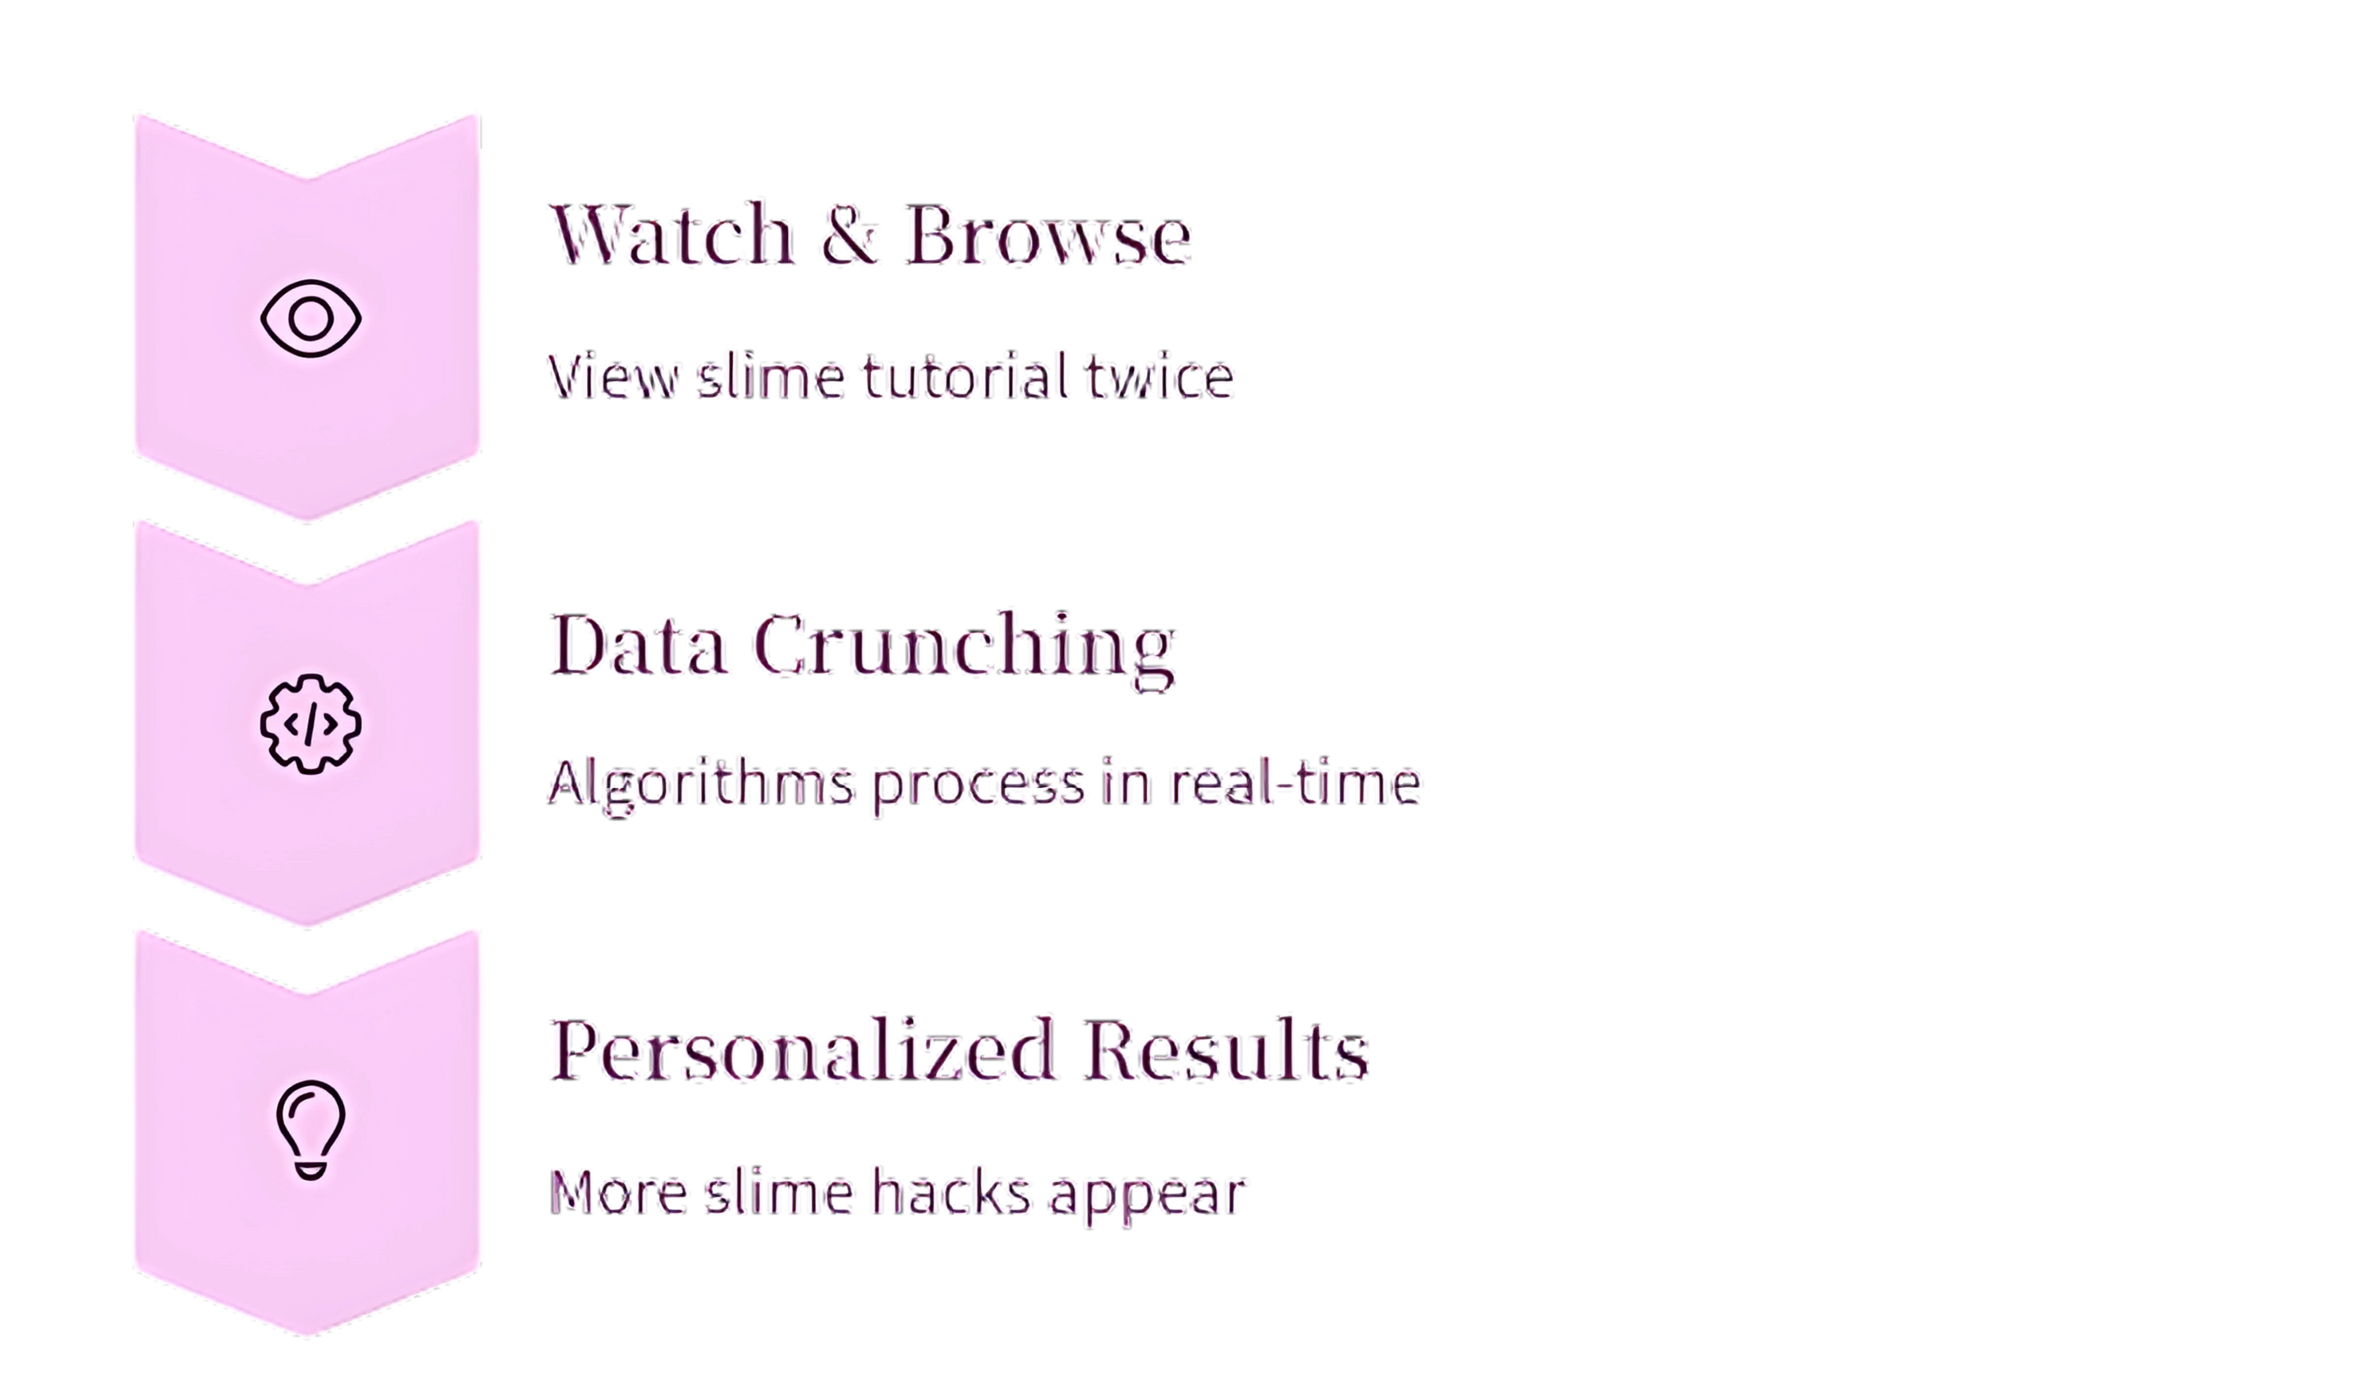
Insta & YouTube in Action

Slide 5
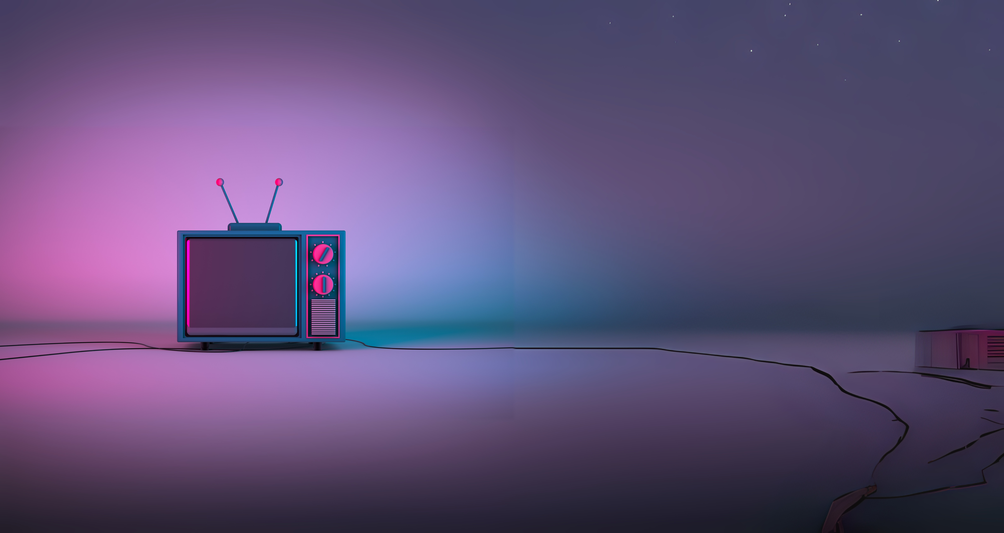

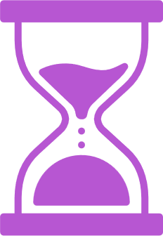

Big Data on
"Old" TV
Smart TVs Are Watching
Sending viewing habits back to networks
Time-Based Patterns
Crime shows at 9 PM = more detective content
Talking Remotes
Your device communicates preferences automatically

Slide 6
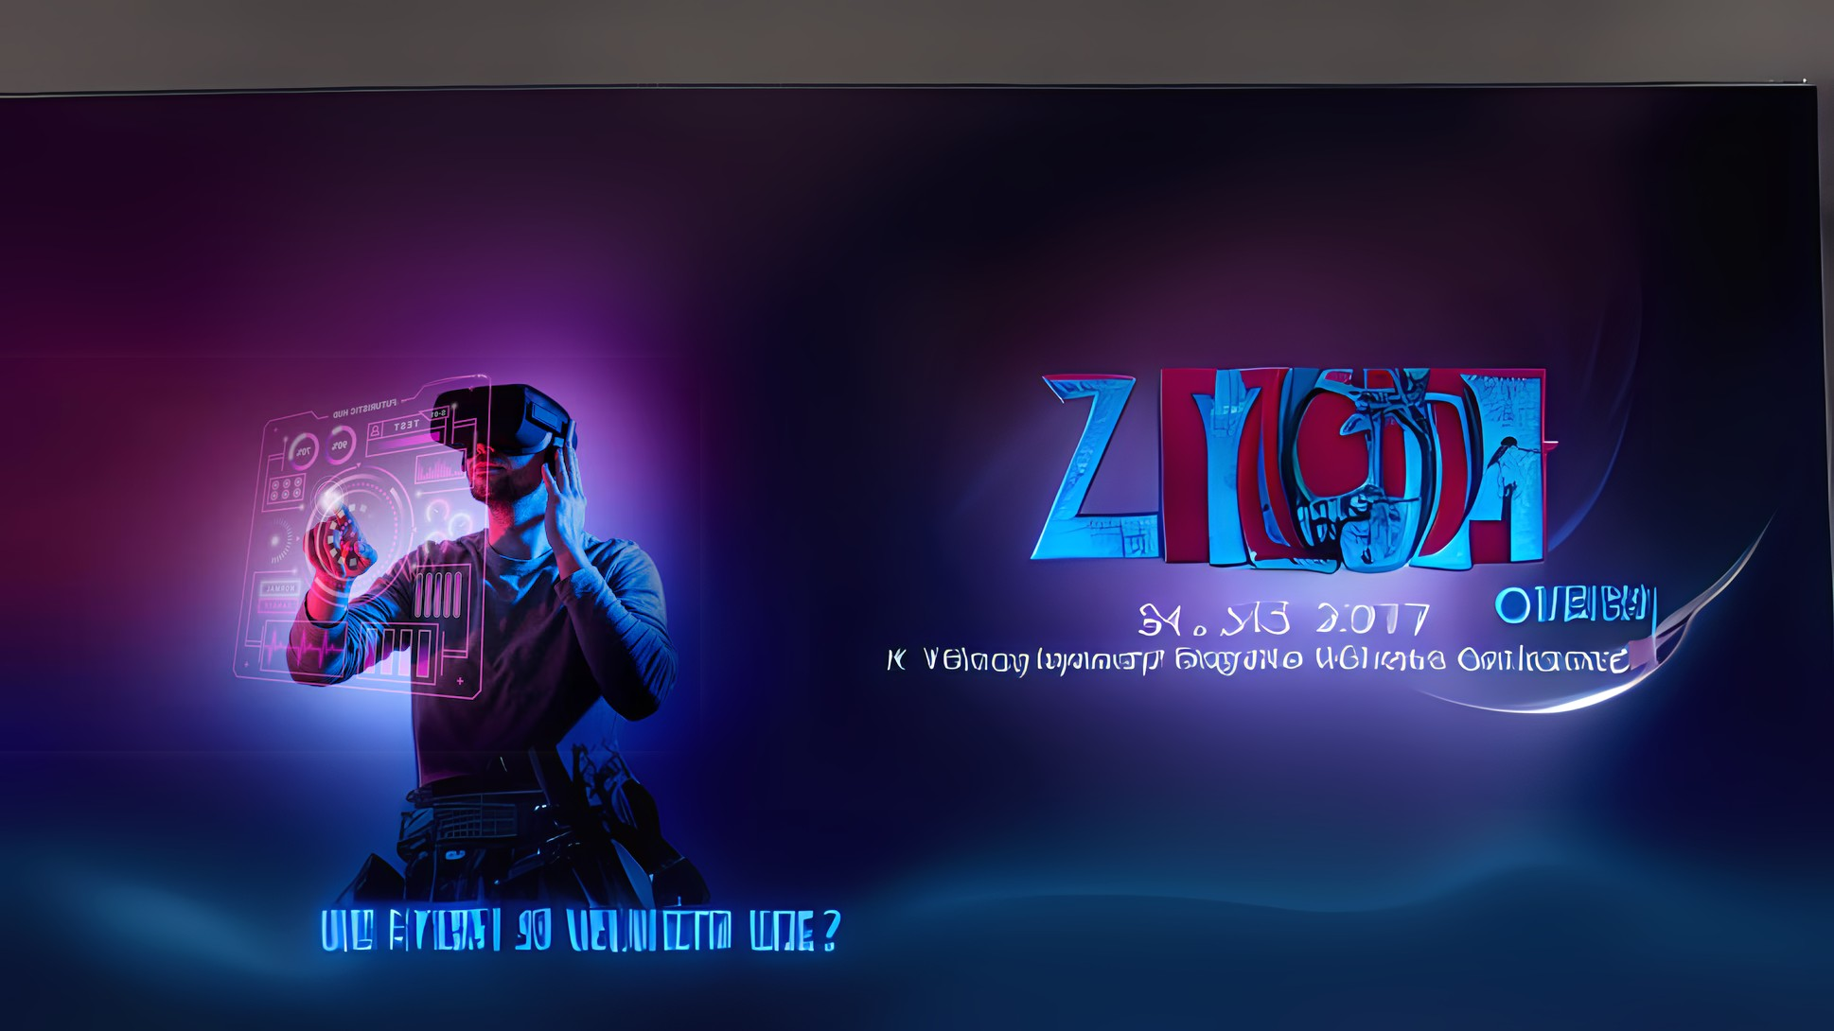

What's Next?
The Future
Camera Sensing
TV detects you nodding off
Dynamic Content
Show switches to exciting scene
Mood Recognition
Phone sees hunger, shows snack ads
Real-Time Adaptation
Big Data + AI sensing emotions

Slide 7
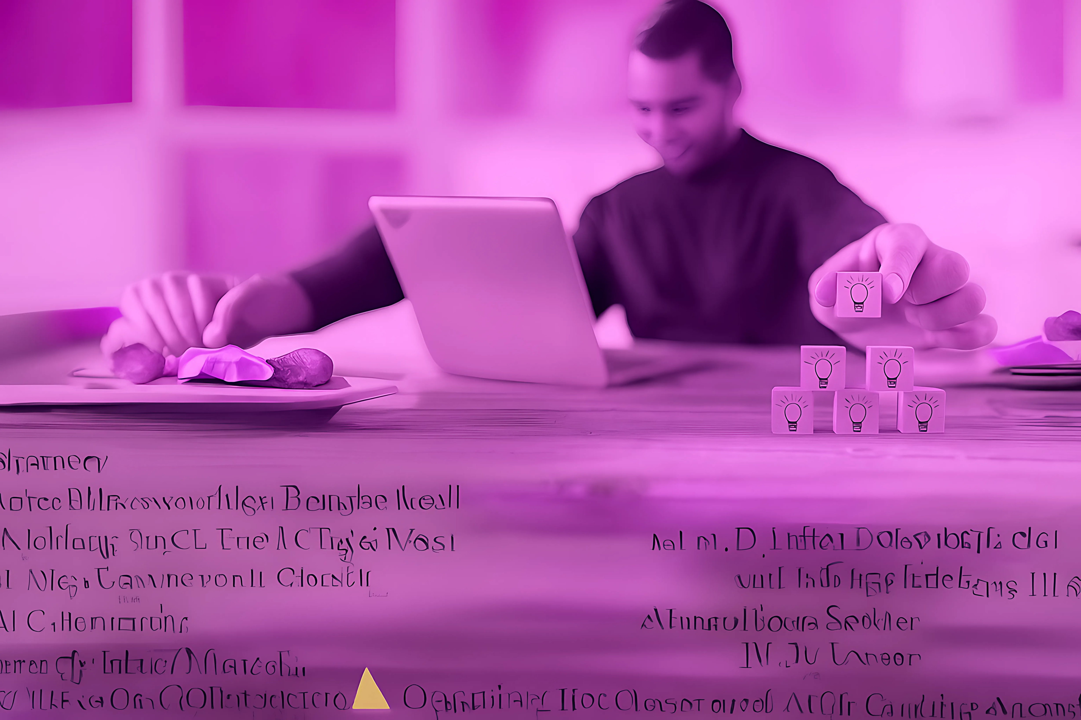
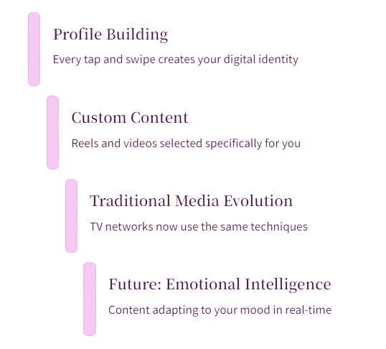
Takeaways

Slide 8
Let’s Flip the Feed:
Q&A Time!
1. If Netflix made a movie about you... Based on your watch history and late-night scrolls, what genre would it be? Comedy, thriller, drama, or something else?
2. Are you in control, or is your feed in control of you? Do you scroll because you're bored, or are you bored because you're scrolling? Who’s really making the decisions here?
3. What if Instagram’s algorithm stopped working? If your feed showed only random content with no personal recommendations, would you still enjoy the app?

Slide 9
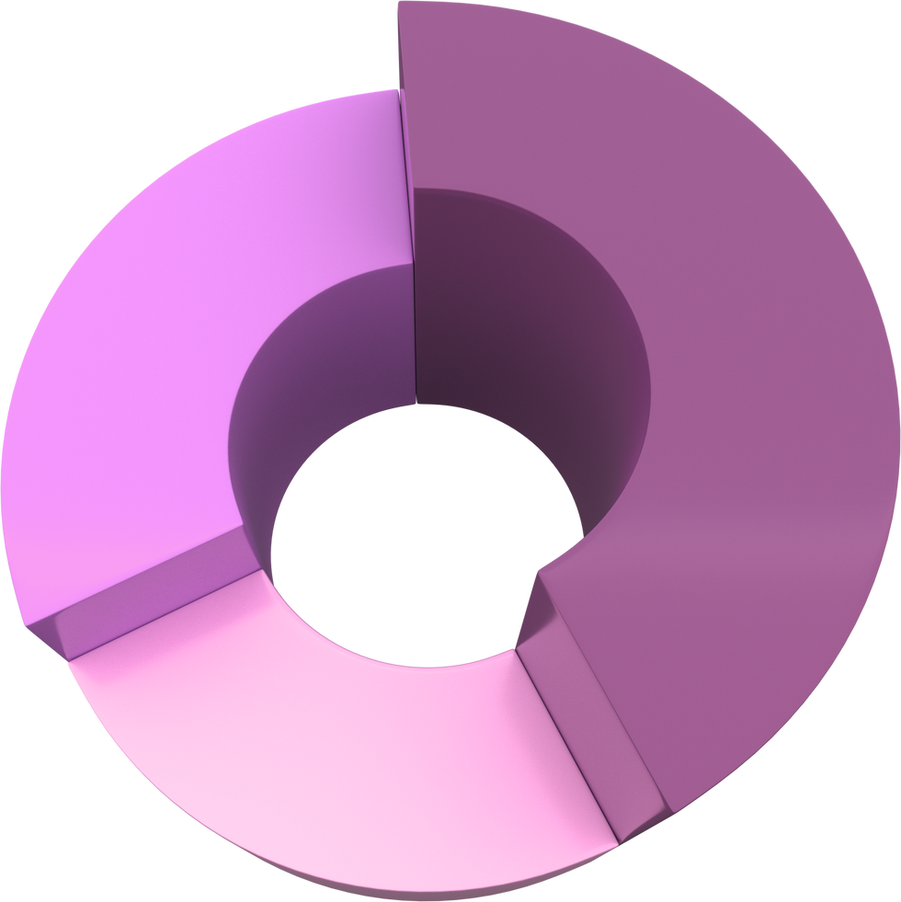

Q&A & Resources
Learn More
Instagram Tech Blog
YouTube's "Inside the Algorithm"
Data's the DJ of your feed!
Your Turn!
Share your cool algorithm finds
Questions about Big Data?
What surprised you most?

Slide 10
Thank
You.
Get In Touch With Us

